Slide 1

DriverPass System Analysis
Brian Larson
Notes:
[No speaker notes required for this slide.]

Slide 2

System Requirements
Functional Requirements
Users have secured profiles with validation
Students and admin can schedule, modify or cancel courses and driving practice.
Non-Functional Requirements
Web-based interface
Data will be stored on cloud-based server
Notes:
[In your speaker notes, include an explanation of the different requirements you determined for DriverPass’s system. What are the functional requirements you selected to describe? What are the nonfunctional requirements you selected to describe? Be sure to explain how these requirements meet DriverPass’s needs.]
Users will need a profile for security, whether they are a student, admin or the CEO. This will allow only authorized users into the system and it will track who makes changes.
Both students and admin can set up, change or cancel appointments. This allows students to do this online, or by calling or visiting the site and having a receptionist do this for them.
The systems will have a web page interface for ease of use across PC and mobile.
All data storage will be handled by an off-site, third-party cloud service.

Slide 3
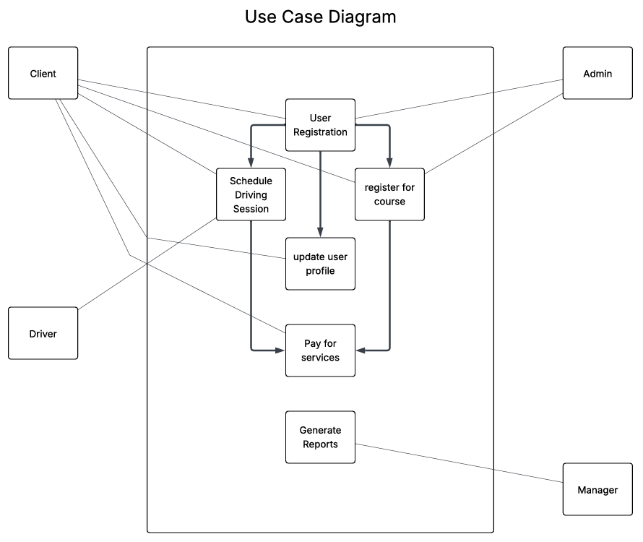
Use Case Diagram
Notes:
[Explain your diagram. Who are the different actors in the system? What are the different use cases? How did you account for DriverPass’s needs in your design? In your explanation, keep your audience in mind. Avoid the use of terms like “actors” and “use cases” in your explanation.]
Use Case for Scheduling
Clients have the ability to register a new profile, and set up courses and driving lessons, as well as making payments for them.
Admin or receptionists can register users in person or via phone, as well as schedule driving lessons and courses.
The driver trainer is notified of upcoming driving lessons and can submit results and feedback after the lessons.
Managers have access to logs and reports to make sure everything Is running smoothly.

Slide 4
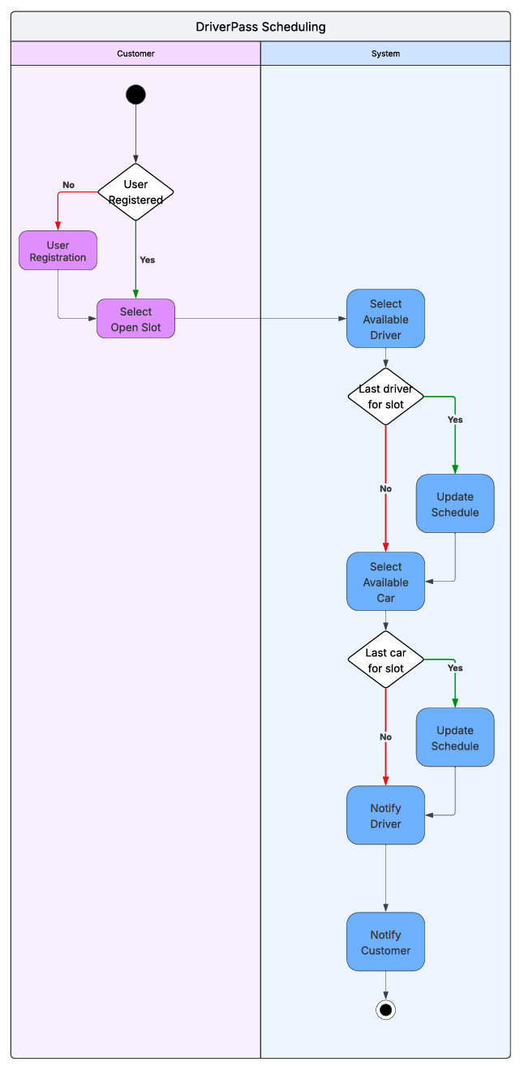
Activity Diagram
Notes:
[Explain your diagram. Which use case are you breaking down? What are the steps for this use case? How did you account for DriverPass’s needs in your design? In your explanation, keep your audience in mind. Avoid the use of technical terms such as “nodes,” “control flows,” and so on.]
Though driving lesson scheduling can be accomplished online, by phone or in person, the process is the same. The user needs to make a profile if they do not have one. Once they do, they select from the available time and date slots. Once they choose, it is entered into the system, which will then assign a driver and a car. If it is either the last car or last driver from that slot, the slot is closed. Once everything checks out, notify both the student and the driver of the appointment confirmation.

Slide 5
Security
Supabase Internal security
SQL Auth
Encrypted connections
CloudFlare
Notes:
[How did you consider security in your design? In your explanation, keep your audience in mind by avoiding the use of technical terms.]
Supabase includes Security measures. This will maintain security by requiring users to log in like your email or bank. It also has an encryption for the communications back and forth.
Cloudflare is a security software that adds to the protection of the system and can prevent the system being shut down by denial-of-service attacks due to hostile overcrowding.

Slide 6
System Limitations
Basic Presentation
Limited Throughput
Driving Packages
Notes:
[What are the limitations of your design? In your explanation, keep your audience in mind by avoiding the use of technical terms.]
This system is meant for limited power. Page presentation should not be overly extravagant or require extreme processing for the web pages.
It cannot host massive transmission streams, such as live streaming.
Driving packages are not easily built for plug and play. To change/add packages, DriverPass will need a technician to code them in.

